Slide 1

Rudiments of Consensus Algorithms
Dr. Ditipriya Sinha
Department of Computer Science & Engineering
National Institute of Technology, Patna

Slide 2
Agenda (1/2)
Some Innate Features of Blockchain Technology
What are Consensus Mechanisms ?
What is a Consensus Algorithm ?
Objectives of the Consensus Process
The Byzantine Generals’ Problem
Problem Statement
Understanding the Byzantine Generals’ Problem
Analogy between Byzantine Generals’ Problem and Blockchain Networks
Importance of Consensus in Blockchain Networks

Slide 3
Agenda (2/2)
Types of Consensus Algorithms
PoW
PoS
DPoS
LPoS
PoET
PBFT
SBFT
DBFT
DAG
PoA
PoI
PoC
PoB
PoWeight
Comparative Analysis between Consensus Algorithms
Conclusion

Slide 4
Some Innate Features of Blockchain Technology
A Blockchain is a decentralized peer-to-peer system with no central authority figure. While this creates a system that is devoid of corruption from a single source, it still creates a major problem.
How are any decisions made?
How does anything get done?
Think of a normal centralized organization.
All the decisions are taken by the leader or a board of decision makers.
This isn’t possible in a decentralized system such as Blockchain because a blockchain has no “leader”.
For the Blockchain to make decisions, they need to come to a consensus using “Consensus Mechanisms”.

Slide 5
What are Consensus Mechanisms ?
Consensus decision-making is a group decision-making process in which group members develop, and agree to support a decision in the best interest of the whole. Consensus may be defined professionally as an acceptable resolution, one that can be supported, even if not the “favorites” of each individual. Consensus is defined by Merriam-Webster as, first, general agreement, and second, group solidarity of belief or sentiment.
In simpler terms, consensus is a dynamic way of reaching agreement in a group. While voting just settles for a majority rule without any thought for the feelings and well-being of the minority, a consensus on the other hand makes sure that an agreement is reached which could benefit the entire group as a whole.

Slide 6
What is a Consensus Algorithm?
Consensus algorithms are a decision-making process for a group, where individuals of the group construct and support the decision that works best for the rest of them. It’s a form of resolution where individuals need to support the majority decision, whether they liked it or not.
In simple terms, it’s just a method to decide within a group.
Example : Imagine a group of ten people that want to make a decision about a project that benefits them all. Every one of them can suggest an idea, but the majority will be in favor of the one that helps them the most. Others have to deal with this decision whether they liked it or not.
Now imagine the same thing with thousands of people. Wouldn’t that drastically make it way more difficult?
Consensus algorithms do not merely agree with the majority votes, but it also agrees to one that benefits all of them. So, it’s always a win for the network.

Slide 7
Objectives of the Consensus Process
Coming to an agreement: The mechanism gathers all the agreements from the group as much as it can.
Collaboration: Every one of the group aims toward a better agreement that results in the groups’ interests as a whole.
Co-operation: Every individual will work as a team and put their own interests aside.
Equal Rights: Every single participant has the same value in voting. This means that every person’s vote is important.
Participation: Everyone inside the network needs to participate in the voting. No one will be left out or can stay out without a vote.
Activity: every member of the group is equally active. There is no one with more responsibility in the group.

Slide 8
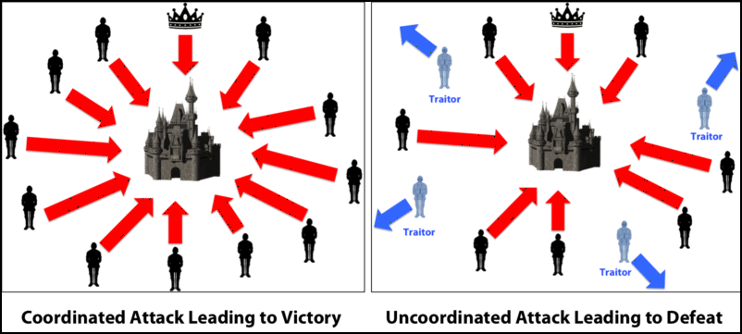
The Byzantine Generals’ Problem

Slide 9
The Byzantine Generals’ Problem (1/2)
Imagine there’s a group of generals, where each one of them owns the Byzantine army. They are going to attack a city and take control, but for that, they’ll need to decide how to attack.
It might seem effortless. However, there’s a slight difficulty. The generals can only communicate through a messenger, and some traitorous generals will try to sabotage the whole attack.
They can send unreliable information through the messenger, or the messenger can even become the enemy here.
The messenger could also intentionally sabotage by delivering the wrong information.

Slide 10
The Byzantine Generals’ Problem (2/2)
This is why the problem needs to be dealt with cautiously.
First of all, somehow we have to make every general come to a mutual decision and
secondly, make sure that even the slightest number of traitors can’t cause the whole mission to fail.
Although it might seem to be quite simple; however, it’s not. According to research, it will take 3n+1 generals to deal with n traitors. It will take four generals to cope with a single traitor, which makes it somewhat tricky.

Slide 11
Understanding the Byzantine Generals’ Problem (1/3)
Consider a group of generals, each commanding a portion of the Byzantine Army, encircle a city. They must decide whether to attack or retreat. But whatever they decide, the most important thing is that they reach a consensus. But consensus is difficult to reach, because generals don’t know the decision of other generals.
Consider the following:
There are 3 generals, general A, B and C
The generals must attack their enemy at the same time, otherwise they may risk failure
The generals have no effective way to communicate instantly
Therefore, they need to send a courier to others to transmit the message

Slide 12
Understanding the Byzantine Generals’ Problem (2/3)
Consider the following:
The generals need to reach consensus before attacking
They must confirm that the other generals will attack at the same time
Therefore, the generals must rally messages and confirmation among each and every one of them before they can launch an attack.

Slide 13
Understanding the Byzantine Generals’ Problem (3/3)
The problem complicates when we consider traitors may exist. We have no way to guarantee all of the messengers are trustworthy, and on top of that, a messenger could be captured and forced to deliver a forged message.

Slide 14
Analogy between Byzantine Generals’ Problem and Blockchain Networks
From the Byzantine Generals’ Problem, we can infer that:
The generals in Byzantine represent nodes on a chain
Each consensus formed by a group of generals represents a block (i.e. set of valid transactions)
All the generals must confirm each other’s decision to reach consensus before launching a coordinated attack. Similarly in a blockchain, all nodes must agree on the next block to be written
Therefore, nodes are subject to failure when:
One of the nodes is sharing inconsistent information (malicious node)
Or in another scenario, fail to respond due to network failure

Slide 15
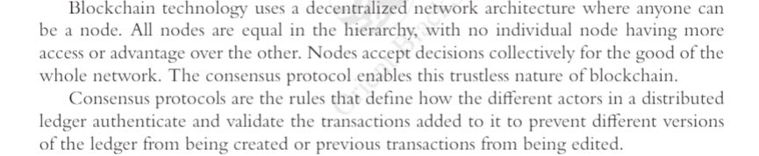

Slide 16
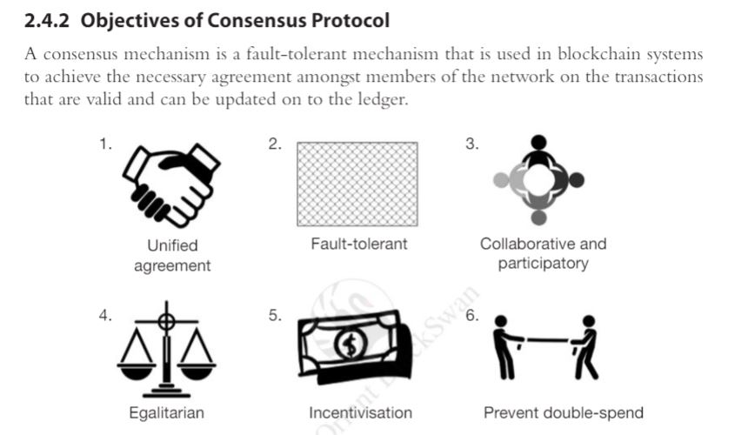

Slide 17
Importance of Consensus in Blockchain Networks
This is why it is important that everyone including the source needs to acknowledge the information everyone else knows.
At the same time, everyone including source needs to be aware of the information each other has.
This creates a scenario where the information acknowledged and known by the majority will be the final decision, i.e. consensus.
Classical Consensus vs Consensus in Blockchain Networks
 | Classical Consensus | Blockchain Consensus
Peer Set | Centralized | Fluctuates depending on incentives
Safety vs Liveness | Focuses on Safety | Focuses on liveness
Sustainability | No reward | Rewarded with in-hand tokens

Slide 18
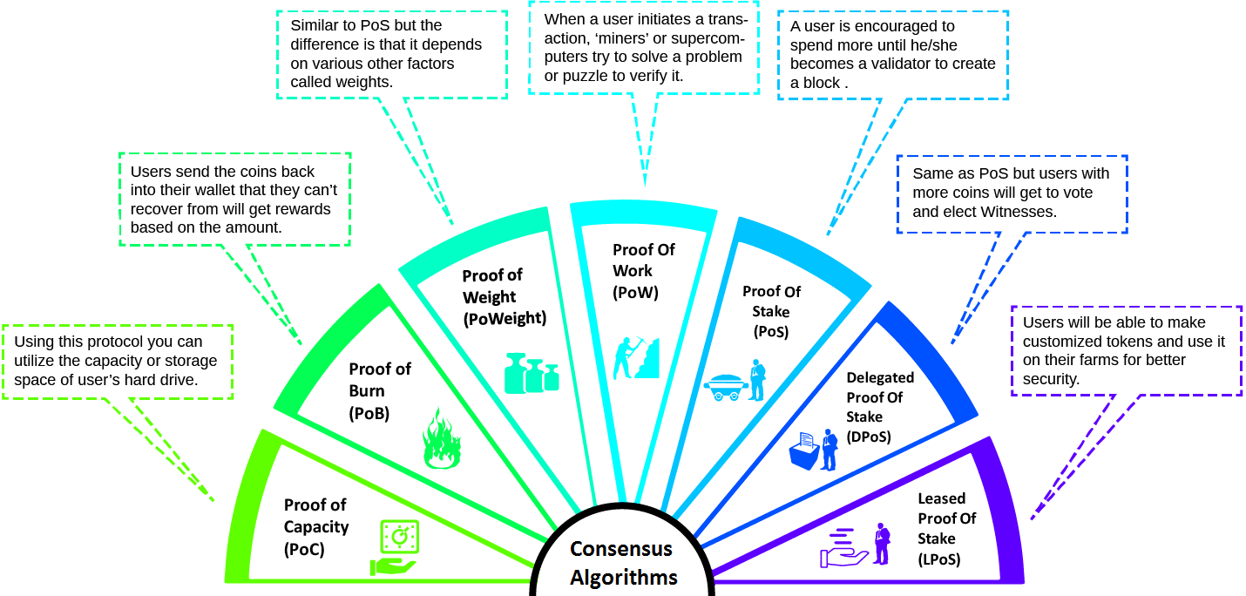
Types of Consensus Algorithms (1/2)

Slide 19
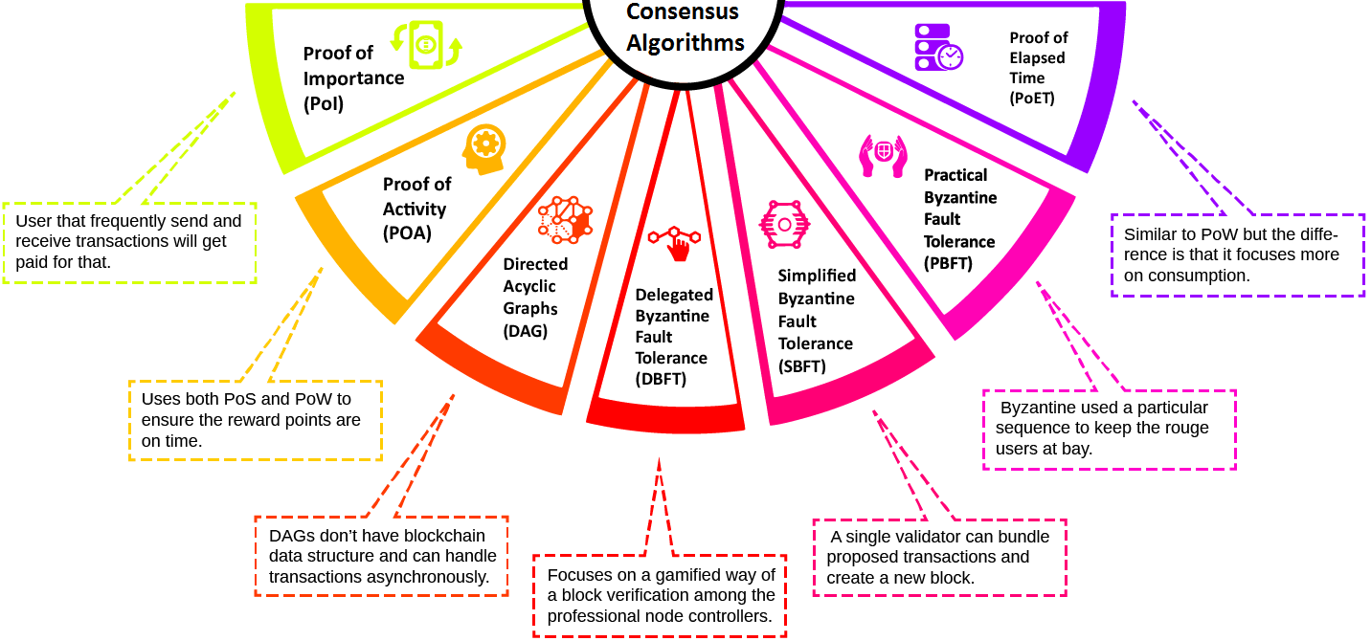
Types of Consensus Algorithms (2/2)

Slide 20
Proof of Work (PoW)
Introduction
Proof of work is the first Blockchain algorithm introduced in the blockchain network. Many blockchain Technologies uses this Blockchain consensus models to confirm all of their transactions and produce relevant blocks to the network chain.
The decentralization ledger system collects all the information related to the blocks. However one needs to take special care of all the transactions blocks.
This responsibility falls upon all the individual nodes called miners and the process they use to maintain it is called mining. The central principle behind this technology is to solve complex mathematical problems and easily give out solutions.

Slide 21
Proof of Work (PoW)
Mathematical Problems/Puzzles
The mathematical problems require a lot of computational power, to begin with. For example, Hash Function or knowing how to find out the output without the input. Another one is that integer factorization, and it also covers tour puzzles.
This happens when the server feels like it has a DDoS attack and to find it out the consensus systems requires a lot of calculation. It’s where the miners come in handy. The answer to the whole problem with the mathematical equation is called the hash.
However proof of work has certain limitations. The network seems to grow a lot, and with this, it needs lots of computational power. This process is increasing the overall sensitivity of the system.

Slide 22
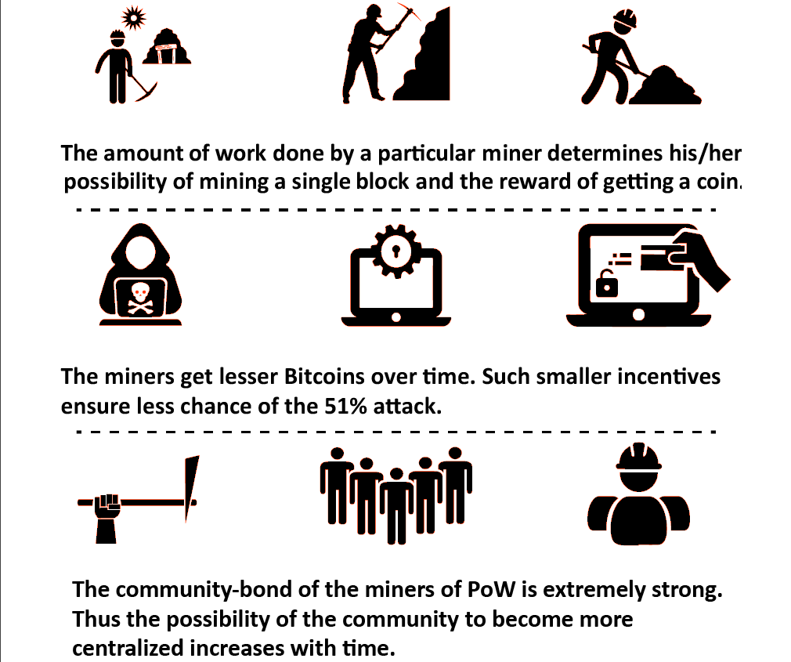
Proof of Work (PoW)
Key Points

Slide 23
Proof of Work (PoW)
Time Criticality
Blockchain consensus sequence relies mostly on accurate data and information. However, the speed of the system lacks tremendously. If a problem becomes too complicated, it takes a lot of time to generate a block.
The transaction gets delayed, and the overall workflow pauses. If the block generation problem can’t be solved within a specific time then generating blocks will become a miracle.
However, if the problem becomes too easy for the system, then it will be prone to DDoS attack. Also, the solution needs to be further checked precisely because not all the nodes can check for possible errors.
If they could then network would lack the most important feature – Transparency.

Slide 24
Proof of Work (PoW)
Implementation
First of all, the miners will solve all the puzzles and after that new blocks will get created and confirm transactions after that. It’s impossible to say how complex a puzzle can be.
It highly depends on the maximum number of users, the minimum current power and the overall load of the network.
New blocks come with Hash Function, and each of them contains the hash function of the previous block. By this way, the network adds an extra layer of protection and prevents any type of violations. Once a miner solves the puzzle, a new block gets created, and the transaction is confirmed.

Slide 25
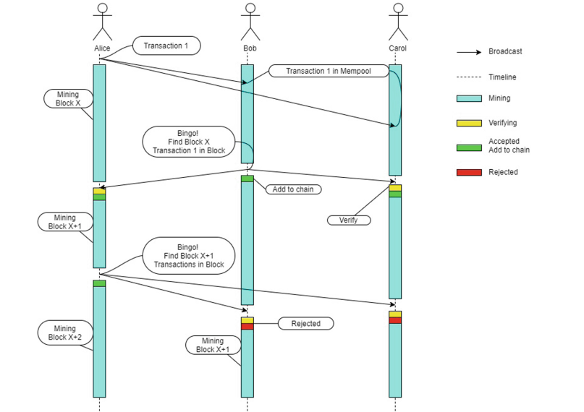
Proof of Work (PoW)
State Diagram

Slide 26
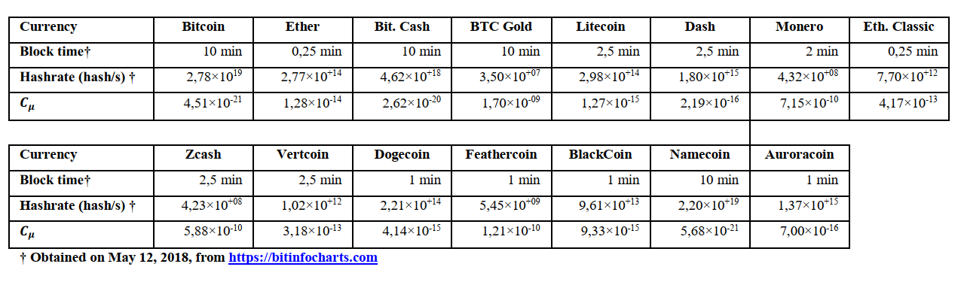
Proof of Work (PoW)
Complexity
Crutchfield’s Statistical Complexity measure 𝐶𝜇
calculated for a few PoW cryptocurrencies.

Slide 27
Proof of Work (PoW)
Examples
The most popular example is Bitcoin. Bitcoin introduced this type of consensus algorithm blockchain before any other cryptocurrencies. The Blockchain consensus models allowed any kind of change in the complexity of the puzzle, based on the overall power of the network.
It takes about 10 minutes to create a new block. Other cryptocurrency consensus example such as Litecoin also offers the same system.
Another blockchain algorithms user, Ethereum, used proof of work in almost 3-4 big projects on the platform. However, Ethereum has moved on to Proof of Stake(PoS).

Slide 28
Proof of Work (PoW)
Issue #1 : Greater Energy Consumption
Blockchain network contains millions and millions of designed microchip that hashes constantly. This process requires a lot of juice.
Bitcoin currently offers 20 billion hashes per second. The miners on the network use some specifically designed microchip to hash. This procedure enables the network to add a layer of protection from botnet attack.
The security level of blockchain network based on proof of work requires a lot of energy, and it’s intensive. The greater consumption is becoming a problem in a world where we are running out of energy – miners on the system have to face a large sum of cost due to the electricity consumption.
The best solution to this problem would be a cheap source of energy.

Slide 29
Proof of Work (PoW)
Issue #2 : Centralization of Miners
With the energy problem, proof of work will move toward cheaper electricity solutions. However, the main problem would be if a bitcoin miner-manufacturer rises. Within a certain time, the manufacturer can become more power hungry and try to create new rules in the mining system.
This situation will lead towards centralization within the decentralized network. That’s why it’s another great problem these Blockchain algorithms is facing.

Slide 30
Proof of Work (PoW)
Issue #3 : The 51% Attack
This attack would mean a possible control of majority users and taking over most of the mining power. In this scenario, the attackers will get enough power to control everything in the network.
They can stop other people from generating new blocks. Attackers can also receive rewards based on their tactics.
Imagine a scenario where Alice is sending Bob some cryptocurrency through the blockchain network. However, Alice is involved in the attack, and Bob is not. The transaction takes place, but the attackers don’t let any amount of money to be transferred by starting a fork in the chain.
In other cases, the miners will join up in one of the branches. They will have the most computational power combined on those blocks. That’s why other blocks with shorter life get rejected. As a result, Bob won’t receive the money.
However, this isn’t the profitable solution. It will take up a lot of mining power, and after the incident getting exposure, users will start to leave the network, and eventually, the trading cost will come down.

Slide 31
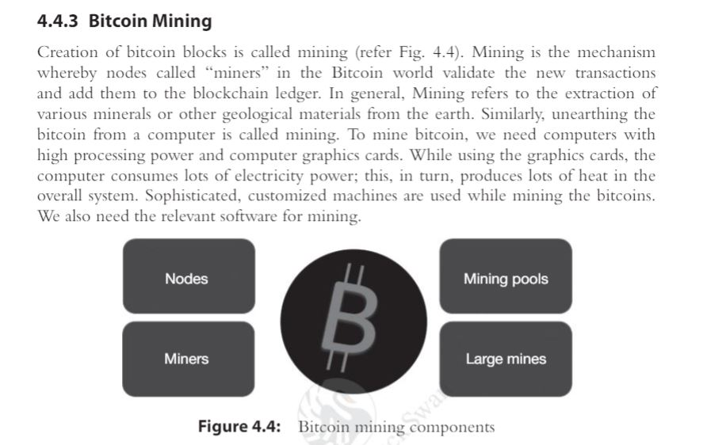

Slide 32
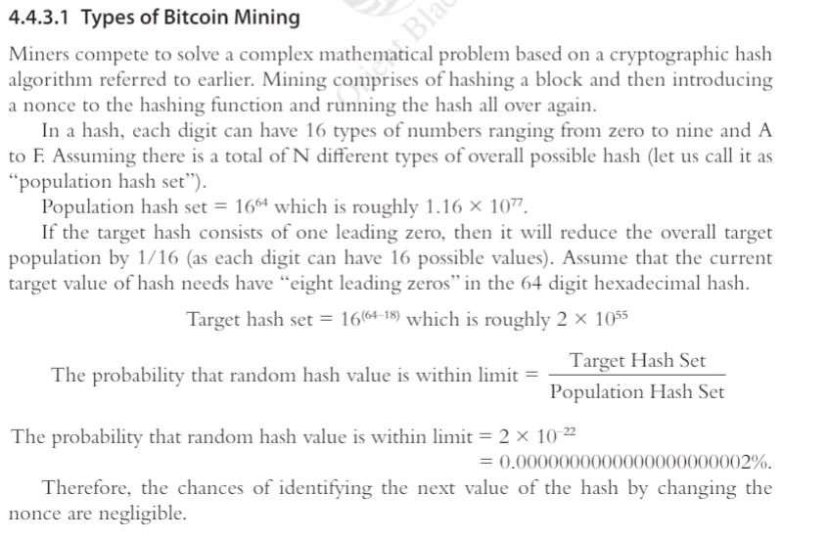

Slide 33
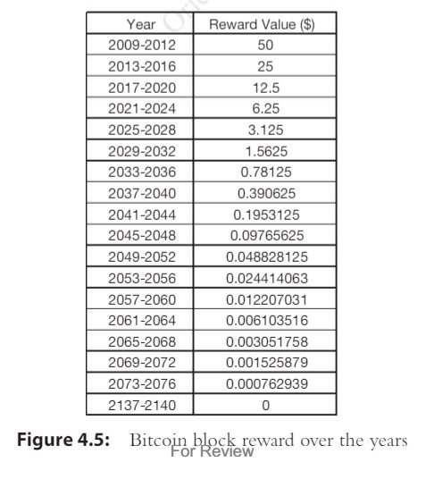

Slide 34
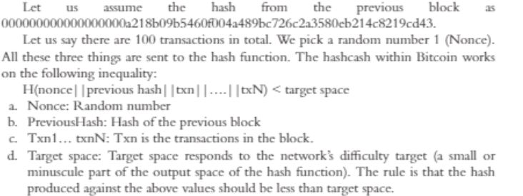

Slide 35
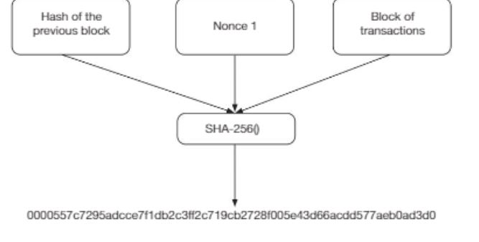

Slide 36
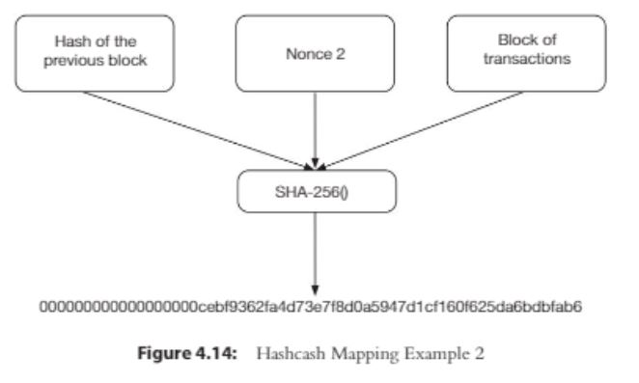

Slide 37
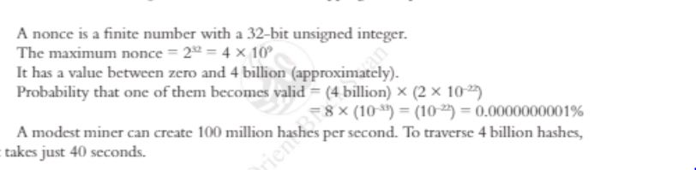

Slide 38
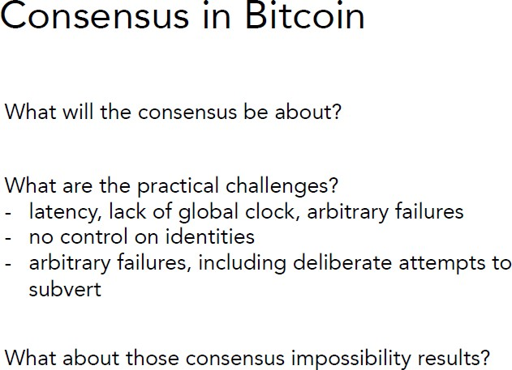

Slide 39
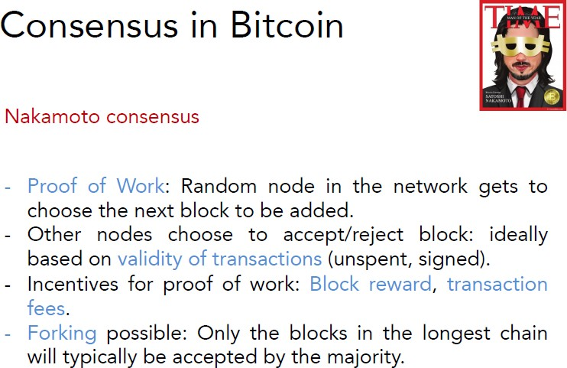

Slide 40
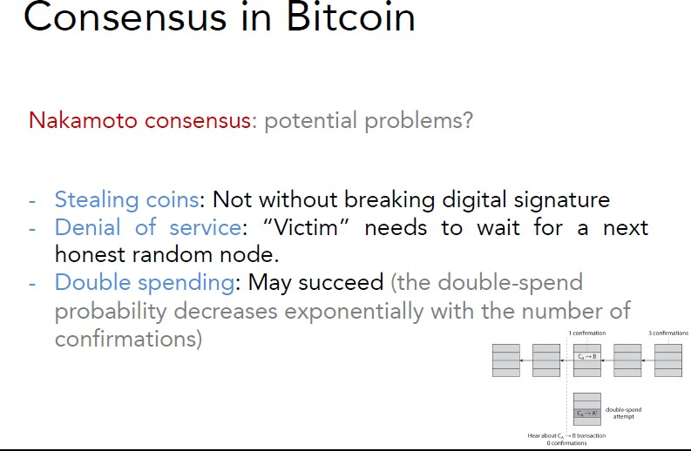

Slide 41
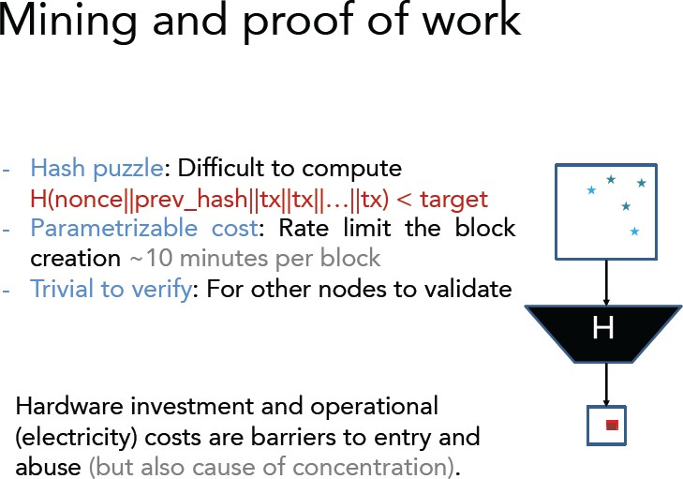

Slide 42
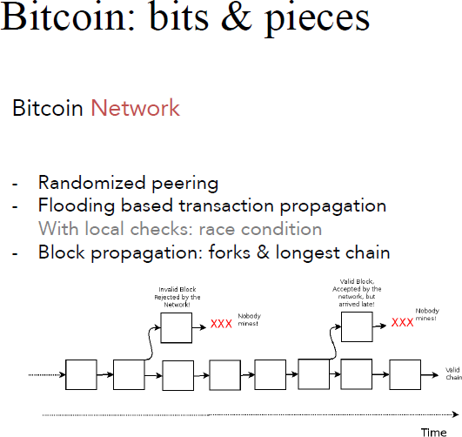

Slide 43
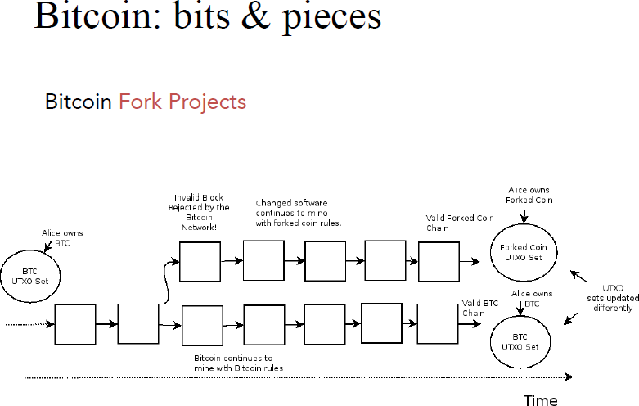

Slide 44
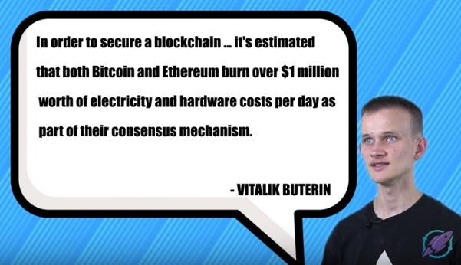

Slide 45
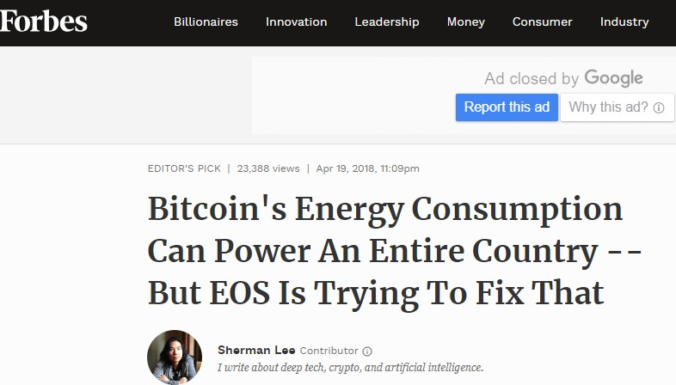

Slide 46
Proof of Stake (PoS)
Introduction
Proof of stake is a consensus algorithm blockchain that deals with the main drawbacks of the proof of work algorithm. In this one, every block gets validated before the network adds another block to the blockchain ledger. There is a little bit of Twist in this one. Miners can join the mining process using their coins to stake.
The proof of stake is a new type of concept where every individual can mine or even validate new blocks only based on their coin possession. So, in this scenario the more coins you have, the better your chances are.

Slide 47
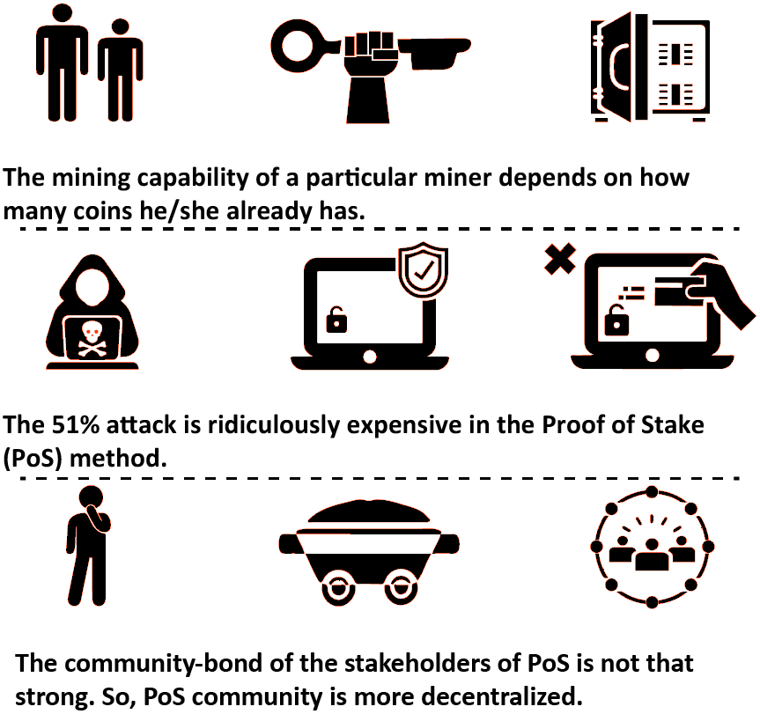
Proof of Stake (PoS)
Key Points

Slide 48
Proof of Stake (PoS)
Pooling
There are other ways to participate in the stacking. If the staking amount is too much high, then you can join a pool and earn profits through that. You can do it in two ways.
First of all, you can loan your coin to another user who will participate in the pool and then share the profit with you. However, you will need to find a reliable person for staking with.
Another method would be to join the pool yourself. This way everyone participating in that specific pool will divide the profit based on the stake amount.

Slide 49
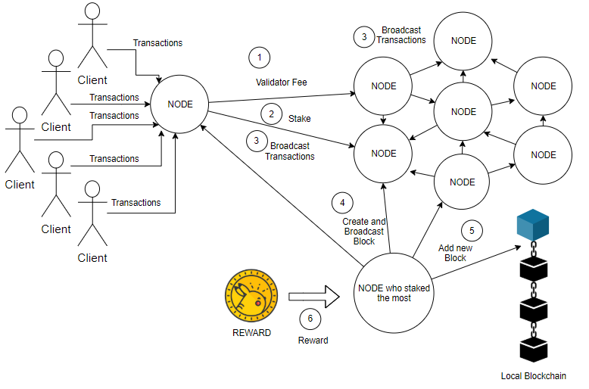
Proof of Stake (PoS)
State Diagram

Slide 50
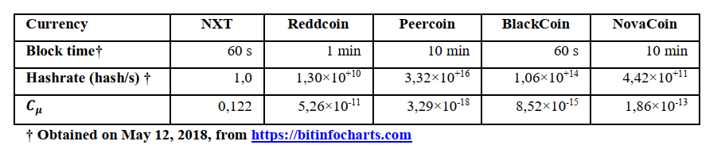
Proof of Stake (PoS)
Complexity
Crutchfield’s Statistical Complexity measure 𝐶𝜇
calculated for a few PoS cryptocurrencies.

Slide 51
Proof of Stake (PoS)
Advantages
First of all, this type of consensus algorithms doesn’t require any amount of heavy hardware backup. You only need a functional computer system and a stable internet connection. Any person who has enough coins on the network will also be able to validate transactions.
If a person invests in the network, it won’t depreciate over time like other investments. The only thing that will affect the profit is the price fluctuations. Proof of stake consensus algorithm blockchain is much more energy efficient then proof of work. It doesn’t even need too much power consumption.
It also reduces the threat of a 51% attack.

Slide 52
Proof of Stake (PoS)
Issues
Even though proof of stake seems quite lucrative than Proof of work, still there is one significant disadvantage. The main drawback of the system is that full decentralization is not possible ever.
This is simply because only a handful of nodes get to participate in the staking on the network. Individuals with the most coins will eventually control most of the system.
Popular Cryptocurrencies Using Proof of Stake as the Base of the Blockchain Technology
PIVX
NavCoin
Stratis

Slide 53
Proof-of-Stake
Miner/Mining Vs. Validator/Minting or forged
POS requires people to prove the ownership of a certain amount of currency
It is believed that people with more currencies would be less likely to attack the network.
If richest person attacks, currency value falls and it may be a loss for the attackers!
Many blockchains adopt PoW at the beginning and transform to PoS gradually.
For instance, Ethereum is planning to move from Ethash (a kind of PoW) (Wood, 2014) to Casper (a kind of PoS) (Zamfir, 2015).

Slide 54
Proof-of-Stake
PoS alternatives consume less energy and reach higher transactions per second.
But they have also still to prove their attack- resistance in real open public settings like PoW so far.
Challenge for proof-of-stake systems is to keep track of the changing stakes of the stakeholders.

Slide 55
Proof-of-Stake
Selection by account balance would result in undesirable centralization because the single richest member would have a permanent advantage as it gets richer.
Different versions: random selection, age- based stake selection (number of coins stake multiply by the time they have been staked, when selected, time reset to 0)…

Slide 56
Proof-of-Stake: Randomization
Blackcoin (Vasin, 2014) uses randomization to predict the next generator.
It uses a formula that looks for the lowest hash value in combination with the size of the stake.

Slide 57
Proof-of-Stake: Coin age
Peercoin (King and Nadal, 2012) favours coin age-based selection.
In Peercoin, older and larger sets of coins have a greater probability of mining the next block.
Once a user has forged a block, their coin age is reset to zero and then they must wait at least 30 days again before they can sign another block.

Slide 58
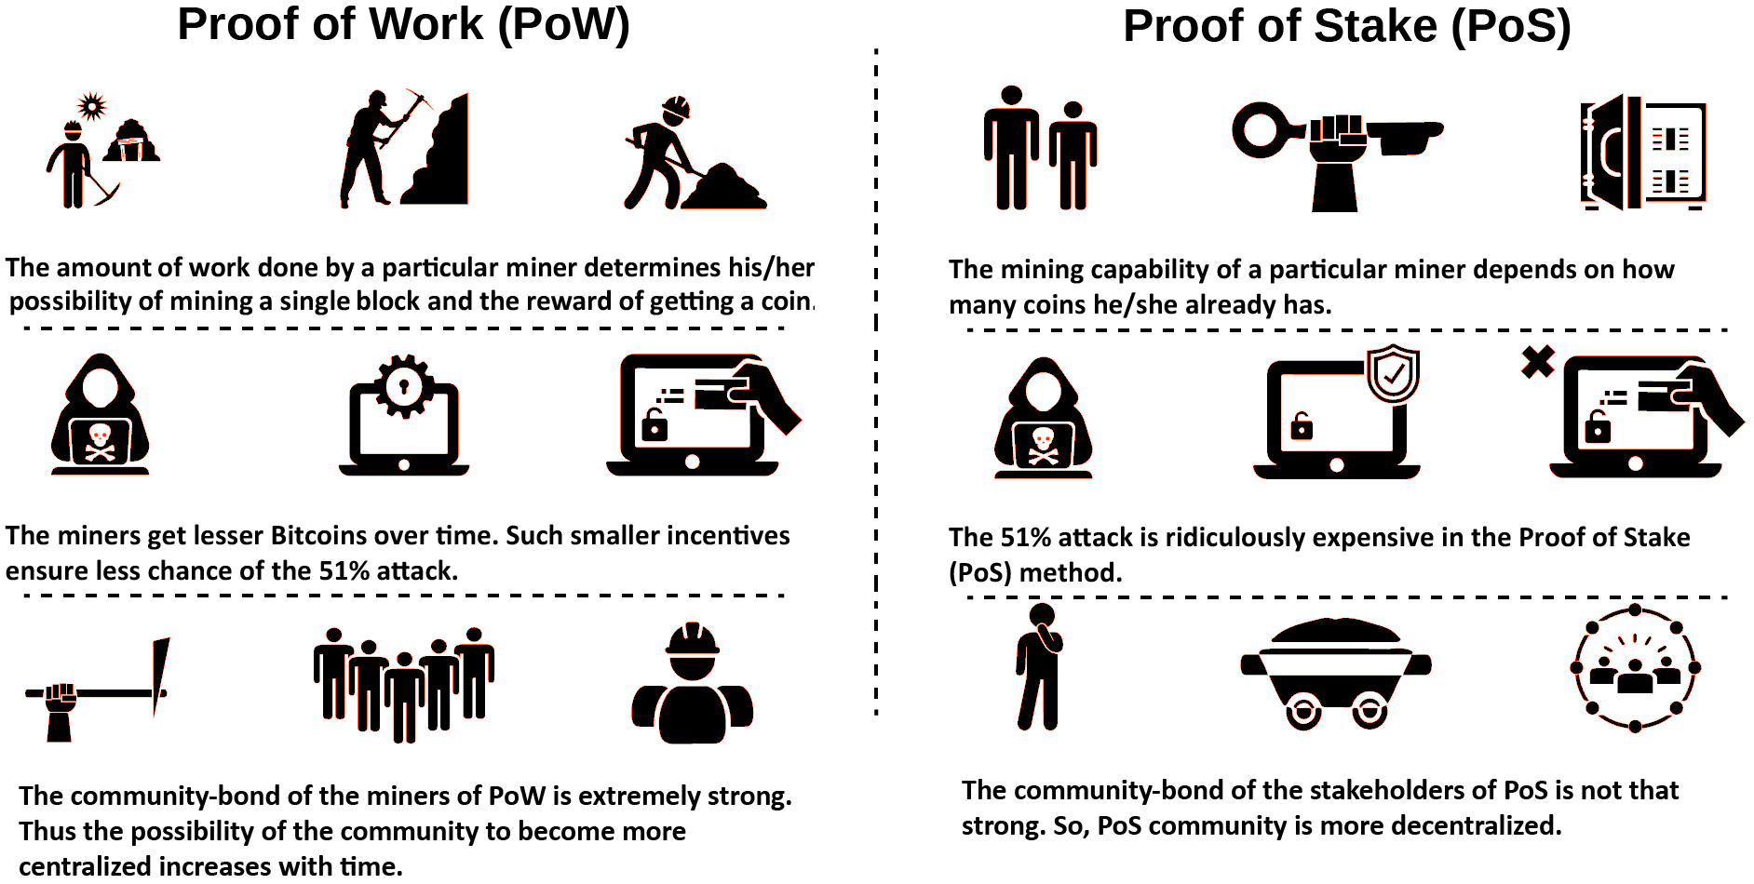
Proof of Work vs Proof of Stake

Slide 59
Delegated Proof of Stake (DPoS)
Introduction
Delegated Proof of Stake is a variation of the typical proof of stake. The system is quite robust and adds a different form of flexibility to the whole equation.
If you want fast, efficient, decentralized consensus algorithms then Delegated Proof of Stake would be the best way to go. The issue of the stakeholders gets fully solved here in a democratic way. Every component on the network can become a delegate.
Here, instead of miners or Validators, the nodes are called delegates. By determining block production, this system can make a transaction within just one second! Moreover, this system was designed to ensure all level of protection against regulatory problems.

Slide 60
Delegated Proof of Stake (DPoS)
Witnesses and Delegates
Usually, witnesses are free from regulations and other neutral words. Standard witness in the traditional contracts has a special place for witnesses to validate. They just make sure that individuals are supposed to get in contact at a specified time.
In DPOS, witnesses can generate blocks of information. There also is a concept of voting to elect the top witnesses. The voting only occurs when the system thinks it’s fully decentralized.
All the witnesses are paid right after it produces a block. The rate gets previously selected through a voting system.
Just like witnesses, delegates get also chosen. Delegates are used for changing the overall network parameters.
With delegates, you’ll get access to transaction fees, block intervals, block sizes and witness pay.
To change a parameter in the network, a majority of delegates need to vote for the same thing. However, delegates won’t get paid like witnesses.

Slide 61
Delegated Proof of Stake (DPoS)
Advantages
In DPOS, the risk of double spending is reduced to a great extent. This can occur when a blockchain network fails to include a previously spent transaction in the database.
The network can check up on its health without anyone’s help and can detect any sort of loss. In this way, it ensures 100% transparency in the database.
Although the system is a variation of proof of stake, still the core transaction system runs entirely on the proof of stake algorithm. The transaction process of the Proof of Stake ensures an added layer of protection against faulty consensus systems.
Example of Blockchain Platform using DPoS : Lisk

Slide 62
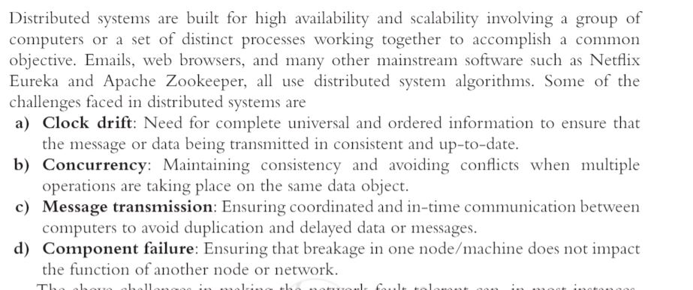

Slide 63
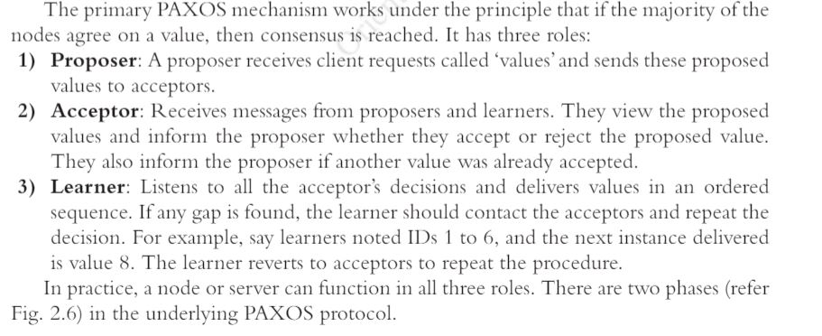

Slide 64
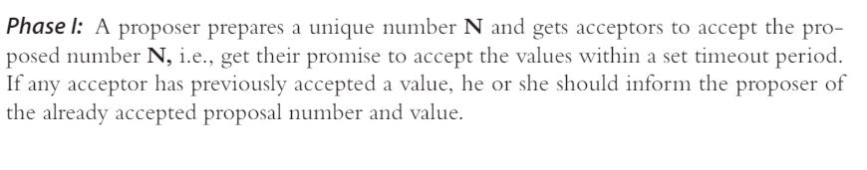

Slide 65
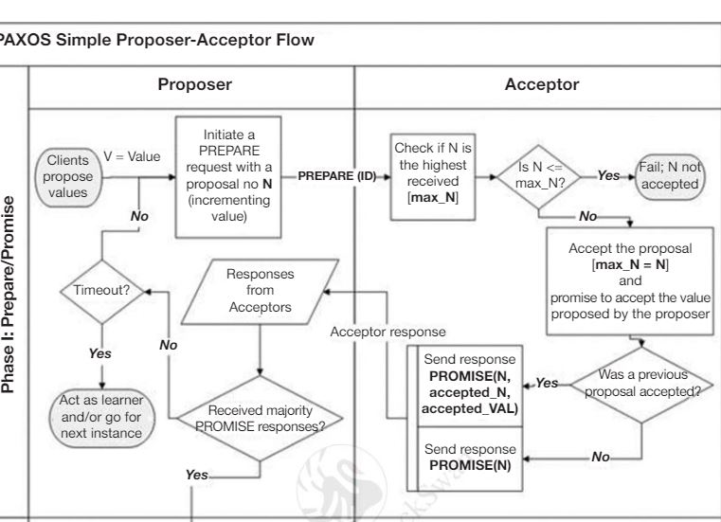

Slide 66
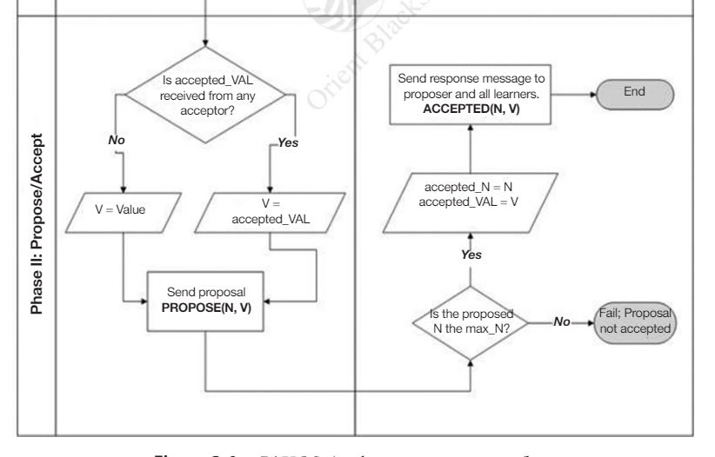

Slide 67
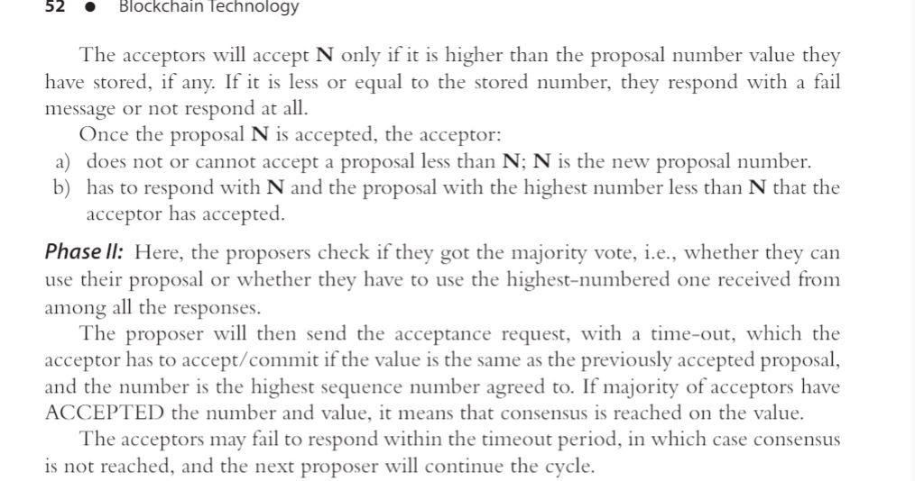

Slide 68
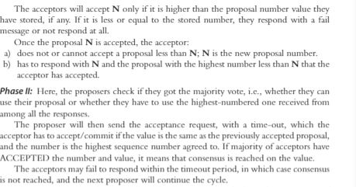

Slide 69
Leased Proof of Stake (LPoS)
This consensus algorithm blockchain was introduced to by Waves platform.
The original proof of stake had some limitations for staking. Individuals with a limited amount of coins might never actually participate in the staking ever. To maintain the network successfully, only a handful of an individual with more coins to offer is left behind. This process allows the system to create a centralized community within a decentralized platform, which is apparently not the desired one.
In leased proof of stake, the smallholders can finally get their chance of staking. They can lease their coins to the network and take the benefit from there. After the introduction to the new Leased Proof of Stake, People with a small number of coins in their wallet would began getting a chance to acquire the benefits like the big fishes. This way it totally establishes the main theme of the consensus algorithms – transparency.

Slide 70
Proof of Elapsed Time (PoET)
Introduction and Advantages
PoET is one of the best consensus algorithms. This particular algorithm is used mainly on permissioned blockchain network where you’ll have to get permission for accessing the network. These permissions networks need to decide on the mining rights or voting principles.
To make sure that everything runs smoothly the PoET algorithms uses a particular tactic for covering transparency into the whole network. The Consensus algorithms also ensure a secure login into the system, as the network requires identification before joining the miners.
Needless to say, this consensus algorithm gives a chance to pick the winners using fair means only.

Slide 71
Proof of Elapsed Time (PoET)
Main Strategy
Every individual on the network has to wait for an amount of time; however, the time limit is totally random.
The participant who has finished his/her fair share of waiting time will get to be on the ledger to create a new block.
To justify these scenarios the algorithm has to consider two facts.
Whether the winner actually chose the random number in the first place? He or She could choose a random short time and get the win first.
Did the individual really wait the specific time he/she were assigned?
PoET depends on a special CPU requirement. It’s called Intel Software Guard Extension (Intel SGX). This Software Guard Extension helps to run unique codes within the network. PoET uses this system and makes sure the winning is purely fair.

Slide 72
Practical Byzantine Fault Tolerance (PBFT)
Introduction
PBFT mainly focuses on the state machine. It replicates the system but gets rid of the main Byzantine general problem. Now, how does it do that?
Well, the algorithm assumes from the start that there could be possible failures in the network and some independent nodes can malfunction at certain times.
The algorithm is designed for asynchronous consensus systems and further optimized in an efficient way to deal with all the problem.
Moreover, all the nodes inside the system gets arranged in a specific order. One node is selected as the primary one, and others work as the backup plan. However, all the nodes inside the system work in harmony and communicate with one another.
The communication level is pretty high because they want to verify every information found on the network. This gets rid of the unreliable information problem.
However, with this new process, they’re able to find out if even one of the node gets compromised. All of the nodes reach an agreement through majority voting.

Slide 73
Practical Byzantine Fault Tolerance (PBFT)
Advantages
No Need for Confirmation:
The transactions on this network work a bit differently. It can finalize a transaction without any type of confirmation as we see in the PoW system.
If the nodes agree on a specific block, then it gets finalized. This is due to the fact that, all the authentic nodes communicate with each other at the same time and come to an understanding of the specific block.
Reduction in Energy:
The new model offers a good amount of reduction in consumption of power than PoW. In the PoW, every block needed individual PoW round. However, in this model, not every miner is solving the typical hashing algorithm.
That’s why the system doesn’t need that much of computational power.

Slide 74
Practical Byzantine Fault Tolerance (PBFT)
Drawback #1 : Communication Gap
The most important factor of this algorithm is the communication among the nodes. Every node on the network has to make sure that the information they gather is solid. However, the Consensus algorithms only happen to work efficiently for a smaller group of nodes.
If the group of nodes increases to a great extent, the system may find it hard to keep track of all the nodes and can’t communicate with every single one of them.
The paper backing this model states to use MACs and other digital signature to prove the authenticity of the information. That being said, MACs aren’t capable of handling the blockchain type network system, so using it would be a significant loss at the end.
The digital signature can be a good point but maintaining security with all these communication nodes would become harder and harder as the number of the node will increase.

Slide 75
Proof-of-Capacity
Sometimes stake could be other things.
For example, proof of capacity (burstcoin, 2014).
In proof-of-capacity, participants vote on new blocks weighted by their capacity to allocate a non-trivial amount of disk space.
Other Examples: PermaCoin, SpaceMint

Slide 76
Proof-of-Capacity
PermaCoin repurposes Bitcoin’s PoW with a more broadly useful task: providing a robust, distributed storage.
SpaceMint employs a consensus protocol based on a non-interactive variant of proof- of-capacity (called proof-of-space).

Slide 77
Proof-of-Deposit
Miners ‘lock’ a certain amount of coins, which they cannot spend for the duration of their mining.
One such system is Tendermint, where a miner’s voting power is proportional to the amount of coins they have locked.
Deposit could be revoked if they misbehaved.

Slide 78
Proof-of-Activity
To combine the benefits of POW and POS, proof of activity (Bentov et al., 2014) is proposed.
In proof of activity, a mined block (based on PoW) needs to be signed by N validators (PoS) to be valid.
In that way, if some owner of 50% of all coins exists, he/she cannot control the creation of new blocks on his/her own.
Since POA marries POW and POS, it draws criticism for its partial use of both.

Slide 79
Delegated Proof-of-Stake
In Delegated PoS (DPOS), stake-holders don’t vote on the validity of the blocks themselves, but vote (proportionately weighted based on the stake) to elect delegates to do the validation on their behalf.
The major difference between POS and DPOS is that POS is a direct democratic while DPOS is representative democratic.
Users can also delegate their voting power to another user who will vote on their behalf.

Slide 80
Delegated Proof-of-Stake
Higher Throughput: With significantly fewer nodes to validate the block, the block could be confirmed quickly, making the transactions confirmed quickly.
Dishonest delegates could be voted out easily.
Examples: Steem and BitShares

Slide 81
Proof-of-Burn
Method for distributed consensus and an alternative to Proof of Work and Proof of Stake
Miners prove that they have destroyed a quantity of coins, for example by sending them to a verifiably unspendable address.
Slimcode implemente this approach in 2014 but has recently been discontinued.

Slide 82
Proof-of-Elapsed-Time
Often used on the permissioned blockchain networks.
Each node in the blockchain network generates a random wait time and goes to sleep for that specified duration.
The one to wake up first – that is, the one with the shortest wait time – wakes up and commits a new block to the blockchain, broadcasting the necessary information to the whole peer network
The same process then repeats for the discovery of the next block.

Slide 83
Proof-of-Elapsed-Time
The POET network consensus mechanism needs to ensure two important factors:
First, that the participating nodes genuinely select a time that is indeed random and not a shorter duration chosen purposely by the participants in order to win, and
Second, the winner has indeed completed the waiting time.

Slide 84
Proof-of-Elapsed-Time
The POET concept was invented during early 2016 by Intel.
It offers a readymade high tech tool to solve the computing problem of "random leader election."

Slide 85
Hyperledger Fabric : PBFT
Practical byzantine fault tolerance (PBFT) is a replication algorithm to tolerate byzantine faults (Miguel and Barbara, 1999).
Hyperledger Fabric (hyperledger, 2015) utilises the PBFT as its consensus algorithm since PBFT could handle up to 1/3 malicious byzantine replicas.

Slide 86
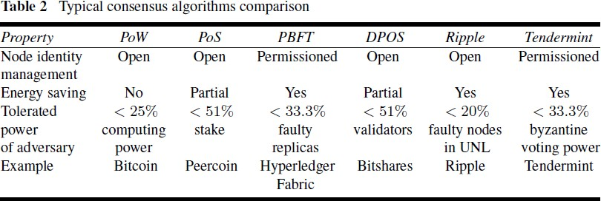
Consensus: A Comparison
Blockchain challenges and opportunities: a survey - by Zibin Zheng et al., 2018

Slide 87
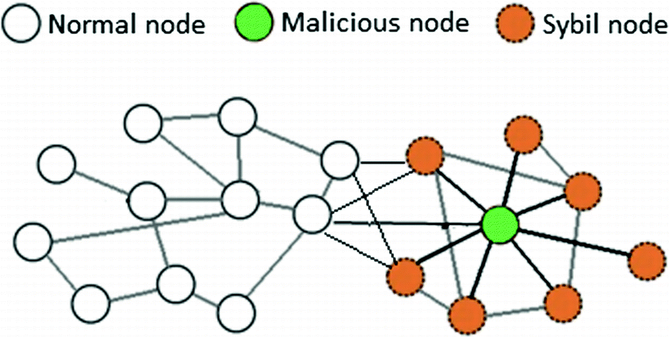
Practical Byzantine Fault Tolerance (PBFT)
Drawback #2 : Sybil Attack
PBFT is quite vulnerable to Sybil attacks. In these attacks, they can manipulate a group of nodes together, and by doing so, they compromise the whole network. This also gets far worse with larger networks, and the scalability of the system gets reduced.
In a Sybil attack, the attacker subverts the reputation system of a network service by creating a large number of pseudonymous identities and uses them to gain a disproportionately large influence.

Slide 88
Simplified Byzantine Fault Tolerance (SBFT)
Working
First, a block generator will collect all the transaction at a time and validate them after batching them together in a new type of block.
In simple terms, a block will gather all the transactions, batch them accordingly into another block and then finally validate all of them together.
The generator applies certain rules that all the nodes follow to validate all the transactions. After that, a block signer will validate them and add their very own signature. That’s why if any of the blocks miss even one of the keys then it will get rejected.

Slide 89
Simplified Byzantine Fault Tolerance (SBFT)
Different Stages
The process starts with the Creation phase, where the asset user will produce a greater number of unique asset IDs.
After that, in the Submission phase, the user submits all the IDs on the platform.
Then begins the Validation phase, where the IDs get specified terms of use cases.
Once they are all signed up, they will get stored and transferred to different accounts. The transactions could happen with the help of smart contracts.
Lastly, the transactions become live.

Slide 90
Simplified Byzantine Fault Tolerance (SBFT)
Security and Privacy (1/2)
SBFT is for a private network where confidentiality is the priority of the network. Primary techniques to enforce security and ensure privacy include :
One Time Use Addresses:
Every time a user wants to receive some assets in his/her wallet, they will be assigned one-time use addresses. Every address differs from each other and thus, prevents any other user to intercept with the transaction.
Zero Knowledge Proof:
Zero knowledge proof is used to conceal all the components of a transaction. However, the entire network would still be able to validate the integrity. This gets done with the help of Zero-Knowledge Proofs where one party will prove their authenticity to another party. In this way, only the receiver and the sender will be able to see the components of the transaction.

Slide 91
Simplified Byzantine Fault Tolerance (SBFT)
Security and Privacy (2/2)
Metadata Encryption:
The metadata of the transitions is also encrypted to ensure further security. The network will allow the usage of keys to validate the authenticity. However, for better protection, the keys will alter every 2-3 days.
Also, all of them are kept separated and on different parts of the data network. So, if one of them gets hacked, one can use other keys to generate more unique keys. Managing these keys and rotating them every few days is necessary for ensuring the integrity of these consensus algorithms.
Chain, a blockchain based platform uses SBFT to validate all of their transaction on the network. Other than that, they are also using an HSM (Hardware Security Module) for an industry level security. By using HSMs, they ensure extra security without the need for any single point failure.

Slide 92
Delegated Byzantine Fault Tolerance (dBFT)
Working
dBFT consensus mechanism looks similar to Delegated Proof-of-Stake. Using a voting process, NEO token holders have the right to vote for delegates. This is regardless of the amount of currency in their possession.
Anyone can become a delegate, as long as he or she meets the requirements. This means a reliable internet connection, the right equipment, a validated identity, and 1,000 GAS. GAS is the reward users receive for their activity on the network. From the delegates, a speaker is chosen randomly.
The speaker builds a new block from the transactions that waits to be validated. Then, the speaker sends the proposal to the elected delegates. They are expected to keep track of all the transactions and record them on the network.
The delegates are free to share and compare the proposal they’ve received to test data accuracy, as well as the honesty of the speaker. The block is added to the blockchain if more than two-thirds of the delegates reach a consensus and validate it.
Voting in the NEO network is a process that occurs in real time.

Slide 93
Delegated Byzantine Fault Tolerance (dBFT)
Countering Dishonesty
As all delegates can verify the block proposal, it’s easy to understand whether the data sent by the speaker is valid or invalid. So, if the speaker is dishonest and sends invalid proposals to two-thirds of the delegates, the blocks won’t match, and node owners won’t validate it. The consensus is reached with two-thirds of the votes, and a new speaker is selected.
If one of the nodes is corrupted, the other delegates can determine the validity of the proposal by comparing their own versions of the proposal. Consensus can still be reached as only two-thirds of the delegates are required to agree to validate the block and replace the dishonest delegate.
Using the Delegated Byzantine Fault Tolerance algorithm, consensus can also be reached when both the speaker and a delegate are dishonest. When comparing blocks, delegates can see whether either the speaker or a delegate is corrupt, and they can agree to invalidate the block, which automatically leads to selecting a new speaker.
In any of these three situations, the dishonest delegates need to control two-thirds of the network to corrupt data written on the blockchain. This is hard to achieve since all NEO token holders can vote, delegates aren’t anonymous, and becoming a node owner costs 1,000 GAS.

Slide 94
Delegated Byzantine Fault Tolerance (dBFT)
Advantages and Disadvantages
Advantages:
Generating a new block on the chain takes between 15 and 20 seconds.
The transaction throughput is close to 1,000 TPS. NEO hopes to reach 100,000 TPS, which would allow the network to support large-scale commercial applications.
No expenditure of energy needed (unlike the Proof-of-Work consensus algorithm).
Total finality for transactions after their confirmation.
There are no forks on the NEO blockchain.
Disadvantages:
As delegates need to operate under real identities to be elected, there’s no anonymity on the blockchain.
The mechanism requires regulated blockchains, which includes a certain level of centralization (exactly what blockchains like Bitcoin and Ethereum are trying to achieve).

Slide 95
Delegated Byzantine Fault Tolerance (dBFT)
Advantages and Disadvantages
Advantages:
Generating a new block on the chain takes between 15 and 20 seconds.
The transaction throughput is close to 1,000 TPS. NEO hopes to reach 100,000 TPS, which would allow the network to support large-scale commercial applications.
No expenditure of energy needed (unlike the Proof-of-Work consensus algorithm).
Total finality for transactions after their confirmation.
There are no forks on the NEO blockchain.
Disadvantages:
As delegates need to operate under real identities to be elected, there’s no anonymity on the blockchain.
The mechanism requires regulated blockchains, which includes a certain level of centralization (exactly what blockchains like Bitcoin and Ethereum are trying to achieve).

Slide 96
Directed Acyclic Graph (DAG)
Working
DAG is basically a form of data structure. While most of the blockchains are a “chain” of “blocks” containing data, DAG is a seamless graph where data gets stored topologically. DAG could come convenient handling specific problems like – data processing, routing, compression.
It takes about 10 minutes to create a block using the Proof-of-Work consensus algorithm. Yes, the PoW is a slowpoke! Rather than working on a single chain, DAG implements the “side-chains.” A side-chain allows different transactions to perform independently on multiple chains.
This will reduce the time of creating and validating a block. Well, actually, it dissolves the necessity of blocks altogether. Moreover, the mining seems to be a waste of time and energy too!
Here, all the transactions are directed and maintain a particular sequence. Moreover, the system is acyclic, meaning the chance of finding the parent node is zero as it a tree of nodes, not a loop of nodes. DAG is showing the world a possibility of blockchains without the blocks!

Slide 97
Directed Acyclic Graph (DAG)
Basic Concepts (1/2)
No More Double Spending
The traditional blockchain allows the mining of on single block at a time. There is a possibility that more than one miner will try to validate a block. This creates a likelihood of double spending.
Moreover, the situation might lead to soft even hard forks. The DAG validates a particular transaction based on the previous number of transactions. This makes the blockchain system safer and more robust.
Less Width
In other consensus algorithms, the transaction nodes get added to the whole network. This makes the width of the system bulkier. Whereas, DAG links the new transactions to the older transaction graph. This makes the entire network lean and more straightforward to validate a particular transaction.

Slide 98
Directed Acyclic Graph (DAG)
Basic Concepts (2/2)
Faster and Smarter
As DAG has blockless nature, it can handle transactions way faster. In fact, it makes the PoW and the PoS look like grandpas in a race.
Favorable to the Smaller Transactions
Not everyone is transacting millions over a single transaction. In fact, the smaller payments are more commonly witnessed. But the substantial payment fees of Bitcoin and Ethereum doesn’t seem that much friendly to the smaller amounts. On the other hand, DAG is perfectly suitable to the smaller ones because of the negligible transaction fees.

Slide 99
Proof of Activity (PoA)
Working (1/2)
In the Proof-of-Activity blockchain consensus protocol, the mining process starts just like the PoW algorithm. The miners solve a critical puzzle to get a reward. So, where is the crucial difference with PoW? In PoW, miners mine blocks that has a complete transaction.
In Proof-of-Activity, miners mine only the template of the blocks. Such a template has two things in them – the header information and the reward address for the miners.
Once, the miners mine these block templates; the system converts to the Proof-of-Stakes. The header information inside a block points to a random stakeholder. These stakeholders then validate the pre-mined blocks.

Slide 100
Proof of Activity (PoA)
Working (2/2)
The more stack a validator holds, the chances of them approving a block increases. Only after the validation, that particular block gets into the blockchain.
This is how Proof-of-Activity uses the best of the two consensus algorithms to validate and add a block to the blockchain. Moreover, the network pays both the miners and the validators the fair share of the transactional fees. Thus the system acts against the “tragedy of the common” and creates a better solution for block validation.

Slide 101
Proof of Activity (PoA)
Advantages and Disadvantages
One of the biggest threats a blockchain face is the 51% attack. The consensus theorem reduces the probability of the 51% attack to zero. It happens as neither the miners nor the validators can be the majority as the process would require equal contribution while adding a block to the network.
Although, some critics say that Proof-of-Activity blockchain consensus protocol has some severe flaws. The first one will be the massive amount of energy consumption due to the mining feature. Second, Proof-of-Activity doesn’t have any solution to put a stop to the double signing of the validators. These two significant flaws kind of makes the consensus theorem a bit back footed.
Two popular blockchains adopt the Proof-of-Activity – Decred and Espers. Still, they have some variations. In reality, Decred is getting considered as the more popular one than the Espers consensus theorem.

Slide 102
Proof of Importance (PoI)
Introduction
The Proof of Importance algorithm is borders around an important idea– harvesting or vesting.
The harvesting mechanism determines whether a node is eligible to be added to the blockchain or not. The more you harvest on a node, the more chances it gets to be added on the chain. In return for the harvesting, the node receives the transaction fees that the validator collects as the reward. To be eligible to harvest, you need to have at least 10,000 XEM on your account.
It solves out the major problem of Proof-of-Stake. In PoS, the richer gets more money compared to the validators having less money. For example, if you own 20% of the cryptocurrency, you can mine 20% of all the blocks on the blockchain network. This makes the consensus algorithms favorable to the wealthy.

Slide 103
Proof of Importance (PoI)
Important Characteristics
Vesting
The most intriguing feature of the consensus theorem is the vesting or the harvesting. As we have said, you need have at least 10,000 coins to be eligible for harvesting in the first place. Your Proof-of-Importance score depends on the harvested amount you have. Although, the consensus algorithms take into account the time period you have the coins in your pocket.
Transaction Partnership
The Proof-of-Importance algorithm will reward you if you make transactions with other NEM account holders. The network will consider you two as partners. Although, the system will catch you if you are planning to make a pseudo partnership.
The Scoring System
The transactions pose an impact to your Proof-of-Importance score. The score is based on the transactions you have made in a thirty-day period. More frequent and more substantial sum will help you to improve your score on the NEM network.

Slide 104
Proof of Capacity
Introduction
Proof-of-Capacity consensus example is an upgrade of the famous Proof-of-Work blockchain consensus protocol. The essential characteristic of this one is the “plotting” feature. You will have to devote your computational power and hard drive storage even before you are starting to mine.
This very nature makes the system faster the PoW. The Proof-of-Capacity can create a block in just four minutes whereas the Proof-of-Work takes ten minutes to do the same. Moreover, it tries to tackle the hashing problem of the PoW system. The more solutions or plots you have on your computer, the better your chances are to win the mining battle.

Slide 105
Proof of Capacity
Working (1/2)
To understand the very nature of the consensus theorem, you must grasp two concepts – the plotting and the mining.
By plotting the hard drive of your computer, you are basically creating a “nonce.” The nonces in the Proof-of-Capacity algorithm are a bit different from the Bitcoin’s. Here, you will have to hash your ID and data until you solve the nonces.
Each of the nonces has a total of 8,192 hashes bundled together. The bundle number is again known as the “scoops.” Each ID can receive a maximum total of 4,095 scoops.

Slide 106
Proof of Capacity
Working (2/2)
The next concept is the “mining” on the hard drive. As we have said, you can receive 0 to 4,095 scoops at a time and store them on your hard drive. You will be assigned a minimum deadline to solve the nonces. This deadline also indicates the time to create a block.
If you can manage to solve the nonces earlier than the other miners, you will get a block as the reward. A famous example could be Burst who has adopted the Proof-of-Capacity algorithm.

Slide 107
Proof of Capacity
Advantages and Disadvantages
Advantages
The mining on the hard drive is way more energy efficient than the regular Proof-of-Work. You will not have to spend fortunes to get expensive mining rigs that we have seen in the Bitcoin protocol. The hard disk of your home PC is just enough to start mining on this consensus algorithm.
Disadvantages
The process creates a massive amount of redundant disk spaces. The system will favor the miners with bigger storage units posing a threat to the decentralized concept. Even the hackers could exploit the system and inject mining malware into the system.

Slide 108
Proof of Burn
Working
The basic idea is that to safeguard the PoW cryptocurrency, a portion of the coins will be burnt! The process happens as the miners send a few coins to an “Eater Address.” The Eater Addresses cannot spend these coins on any purpose. A ledger keeps track of the burnt coins making them genuinely unspendable. The user who burnt the coins will get a reward as well.
Yes, the burning is a loss. But the damage is temporary as the process will safeguard the coins in the long run from the hackers and their cyber-attacks. Moreover, the burning process increases the stakes of the alternative coins.
Such a scenario increases the chance of a user to mine the next block as well as increases their rewards in the future. So, burning could be used as a mining privilege. The counterparty is an excellent consensus example of a cryptocurrency that uses this blockchain consensus protocol.

Slide 109
Proof of Burn
The Eater Address
To burn coins, users send them to the Eater Addresses. An Eater Address doesn’t have any private key. So, no user can ever access these addresses to spend the coins held within. Moreover, these addresses get generated in a random fashion.
Although these coins are inaccessible or “gone forever (!)”, they are considered as calculated supply and labeled as burnt.

Slide 110
Proof of Burn
Advantages and Disadvantages
Advantages
The primary reason behind burning the coins is to create more stability. We know the long-term players tend to hold coins for a long time for profits.
The system favors those long-term investors by giving more stable currency and long-term commitment. Moreover, this enhances the decentralization and creates a better-distributed network.
Disadvantages
But from whichever angle you look at the scenario, burning coins means wasting it! Even some eater addresses have more than $100,000 worth of Bitcoins in them. There is no way to recover the money – they get burnt!

Slide 111
Proof of Weight
This is a big upgrade of the Proof-of-Stake algorithm. In Proof-of-Stake, the more token you own, the better your chances are to discover more! This idea makes the system a bit biased.
The Proof-of-Weight tries to solve such biased nature of the PoS. Cryptocurrencies like Algorand, Filecoin, and Chia implement the PoWeight. The Proof-of-Weight considers some other factors than owning more tokens like in PoS.
These factors get identified as the “Weighted Factors.” For example, Filecoin considers the amount of IPFS data that you have and weights that factor. Some of the other factors include but not limit to Proof-of-Spacetime and Proof-of-Reputation.
The fundamental advantages of this system include customization and scalability. Although incentivizing could be a big challenge for this consensus algorithm.

Slide 112
Comparative Analysis Between Various Consensus Algorithms (1/2)
Consensus Algorithms | Blockchain Platform | Launch Year | Coded In | Smart Contracts | Advantages | Disadvantages
PoW | Bitcoin | 2009 | C++ | No | Less opportunity for 51% attack | Greater energy consumption
 |  |  |  |  | Better Security | Centralization of Miners
PoS | NXT | 2013 | Java | Yes | Energy efficient | Nothing-at-stake problem
 |  |  |  |  | More decentralized
DPoS | Lisk | 2016 | JavaScript | No | Energy efficient, | Partially centralized
 |  |  |  |  | Scalable,
 |  |  |  |  | Increased security | Double spend attack
LPoS | Waves | 2016 | Scala | Yes | Fair usage | Decentralization Issue
 |  |  |  |  | Lease Coins
PoET | Hyperledger Sawtooth | 2018 | Python, JavaScript, Go, C++, Java, and Rust | Yes | Cheap participation | Need for specialized hardware
 |  |  |  |  |  | Not good for Public Blockchain
PBFT | Hyperledger Fabric | 2015 | JavaScript, Python, Java REST and Go | Yes | No Need for Confirmation | Communication Gap
 |  |  |  |  | Reduction in Energy | Sybil Attack
SBFT | Chain | 2014 | Java, Node, and Ruby | No | Good Security | Not for Public Blockchain
 |  |  |  |  | Signature Validation

Slide 113
Comparative Analysis Between Various Consensus Algorithms (2/2)
Consensus Algorithms | Blockchain Platform | Launch Year | Coded In | Smart Contracts | Advantages | Disadvantages
DBFT | NEO | 2016 | Python,.NET, Java, C++, C, Go, Kotlin, JavaScript | Yes | Fast, Scalable | Conflictions in the Chain
DAG | IOTA | 2015 | Javascript, Rust, Java Go, and C++ | In Process | Low cost network | Implementation gaps
 |  |  |  |  | Scalability | Not suited for smart contracts
POA | Decred | 2016 | Go | Yes | Reduces the probability of the 51% attack | Greater energy consumption
 |  |  |  |  | Equal contribution | Double signing
PoI | NEM | 2015 | Java, C++XEM | Yes | Vesting, Transaction Partnership | Decentralization Issue
PoC | Burstcoin | 2014 | Java | Yes | Cheap | Favoring bigger fishes
 |  |  |  |  | Efficient | Decentralization issue
 |  |  |  |  | Distributed
PoB | Slimcoin | 2014 | Python, C++, Shell, JavaScript | No | Preservation of the network | Not for short term investors
 |  |  |  |  |  | Wasting coins
PoWeight | Filecoin | 2017 | SNARK/STARK | Yes | Scalable, Customizable

Slide 114
Conclusion
Mechanisms for achieving consensus are vital to the functioning of distributed systems. Many believe that the greatest innovation in Bitcoin was the use of Proof of Work to enable users to agree on a shared set of facts.
Consensus algorithms today underpin not only digital money systems, but blockchains allowing developers to run code across a distributed network. They’re now a cornerstone of blockchain technology and are critical to the long-term viability of the various networks in existence.
Of all of the consensus algorithms, Proof of Work remains the dominant offering. An alternative that’s more reliable and more secure has yet to be proposed. That said, there’s a tremendous amount of research and development into replacements for PoW, and we’re likely to see more of them surface in the coming years.

Slide 115
Thank You

